Slide 1

Surgical Technology Program
Presented by: Heidi Barry

Slide 2
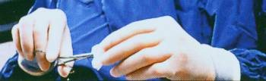
Program Overview: Nature of the work
They:
  Set up surgical instruments, equipment, sterile drapes, and sterile solutions.
  Cover the patient with sterile surgical drapes.
  Help the surgical team put on sterile gowns and gloves.
  Anticipate the needs of the surgeon throughout the procedure
  Are responsible for counting supplies and instruments.
“Scrubs” assist in surgical operations under the supervision of surgeons.
They are members of operating room team.

Slide 3
What is a CST career like?
Working in the operating room
Standing long hours
Lifting or holding retractors
On Call over night or all day
8 - 10 -12 hour shifts
Exposed to:
  Blood
  Diseases
  Body fluids
  X-ray
  Sharps – knifes & needles

Slide 4

Program Overview: Degrees Awarded
Graduates receive and Associate of Sciences Degree in Surgical Technology
There is no Baccalaureate degree in Surgical Technology.
Limited enrollment of 20 students annually into the clinical phase.
Unlimited number of students may enroll in the pre-clinical phase.

Slide 5

Program Overview: Length of Program
Although it is a 2-year program, some students take 3 years for completion due to:
  need for developmental courses prior to beginning the college level course work
  repeating courses when not successful
  delay in acceptance into the clinical phase

Slide 6
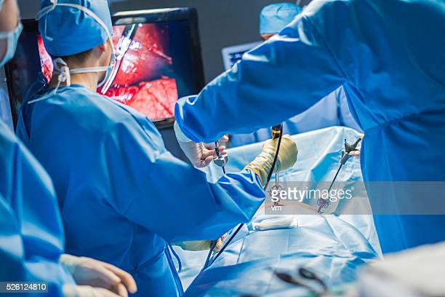
Student Selection
1st year enrollment: not limited
Enrollment in the second year is limited to 20 clinical students beginning each fall semester.
Selection is based:
  GPA

Slide 7
Student Advising
1st semester, students must go to the Advising Center in Ivy Hall to schedule classes.
Thereafter, student may register online & are advised by SURG faculty in the School of Health Sciences in Ivy Hall 2144.
Accurate advising is critical in verifying that you are taking the appropriate courses & following procedure.
Amy Becker is the advisor for Health Sciences

Slide 8


Program Overview: Accreditation
Accredited by the Commission on Accreditation of Allied Health Education Programs (CAAHEP) in collaboration with the Accreditation Review Committee on Education in Surgical Technology and Surgical Assisting (ARC-STSA).

Slide 9
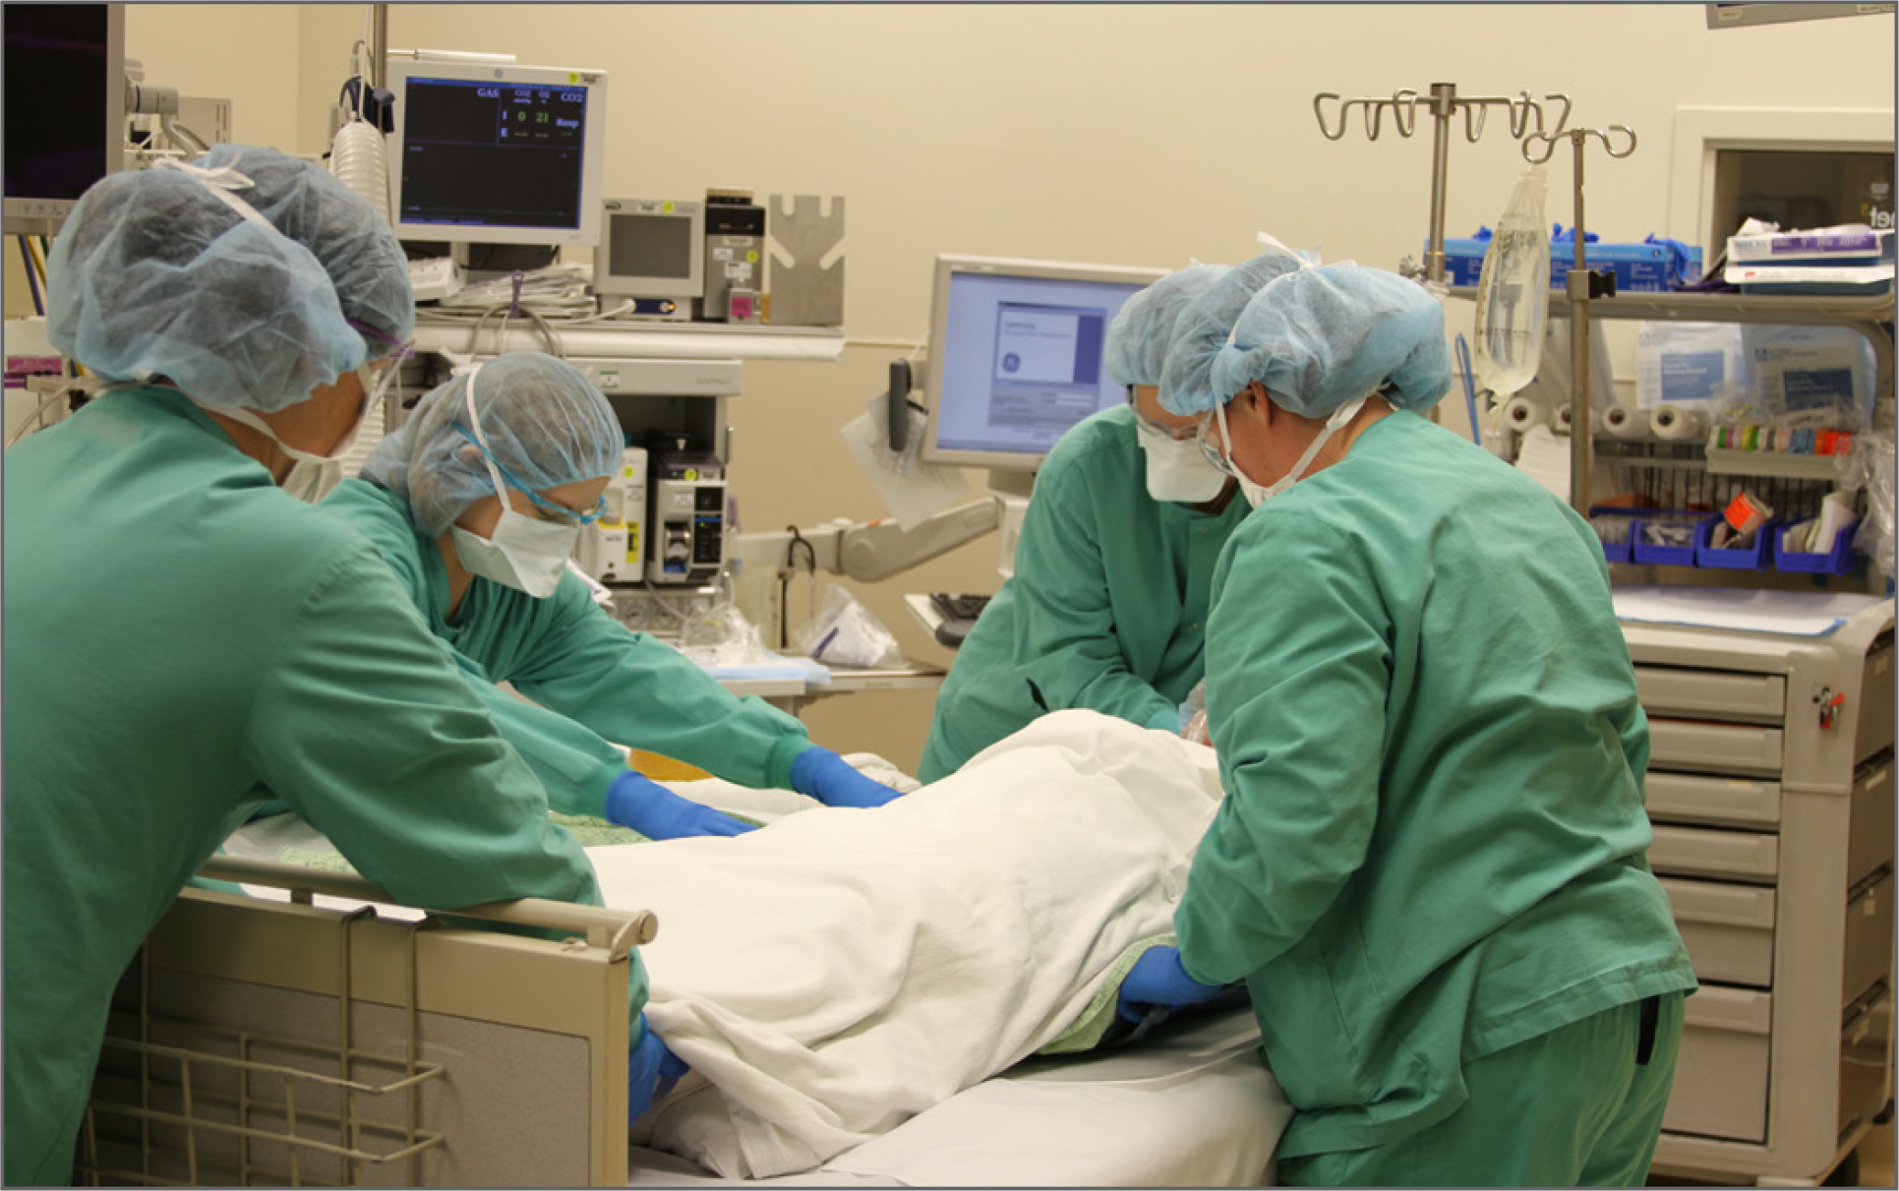
Program Accreditation
Most recent onsite visit in November 2005 received full accreditation.
Accreditation is on-going with an annual report & onsite visit every 10 years.
There is no expiration date for the accreditation.

Slide 10
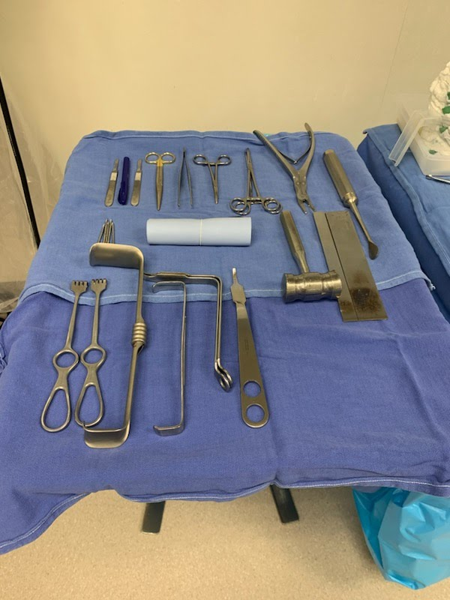
Program Overview: Full-Time Faculty
  Heidi Barry, BA, MA, CST
    Master Degree in Art
    Bachelors Degree in K-12 Art
    Certified Surgical Technologist

Slide 11
Program Overview: Full-Time Faculty
  Jessica Clawson
    Certified Surgical Technologist
    Currently working on Bachelor’s Degree

Slide 12

Professional Organization
Association of Surgical Technologists (AST)
Primary purpose is to ensure that surgical technologists & surgical assistants have the knowledge and skills to administer patient care of the highest quality.
www.ast.org for more information

Slide 13
Market Demand Analysis
According to the 2009 Occupational Outlook Quarterly:
Surgical technologists held about 91,500 jobs.
Projected Employment about 114,700 jobs in 2018
The Lafayette job market in the past years seem is stability for local jobs.
Within 3 months before graduation in 2021, half of the graduates were hired.
In 2020 and 2021, the majority of the students were hired after graduation.
Currently 70 open position at IU Health in Indiana

Slide 14
Market Demand Analysis:
According to the May 2009 Occupational Outlook Quarterly:
Median annual earnings of annual salary of surgical technologists were $39,400.
Median average hourly pay is $18.94 per hour.
Arnett IU starts at $20
Franciscan Health starts at $22
Median annual earnings in the industries employing the largest numbers of surgical technologists were:
  Outpatient care centers 41,320
  Offices of physicians 41,260
  General medical and surgical hospitals 40, 330
  Offices of dentists 38,060

Slide 15
Personal Traits
A good Certified Surgical Technologist is:
  Organized with good attention span
  Has good manual dexterity
  Thrives in a fast paced environment
  Accepts direction from superior(s)
  works well with team members
  Has an eye for detail yet is flexible when needed
  Is precise in follow through
  Has good communication skills
  Has a desire to help people

Slide 16
Curriculum – Clinical Year
Technical Core (38 credits)
  SURG 111 Fundamentals of Surgical Technology
  SURG 112 Applications of Surgical Fundamentals
  SURG 113 Surgical Procedures I
  SURG 114 Clinical Applications II
  SURG 211 Surgical Procedures II
  SURG 212 Clinical Applications II
  SURG 213 Surgical Procedures III
  SURG 214 Clinical Applications III

Slide 17
Curriculum – Pre-clinical
General Education (22 credits)
  APHY 101 & 102 Anatomy & Physiology I & II
  BIOL 211 General Microbiology
  MATH 1XX Mathematics Elective
  ENGL 111 English Composition
  COMM 101/102 Fund. of Public Speaking or Intro. to Interpersonal Communications
  SOCI 111/PSYC 101 Intro to Sociology or Psychology
  IVYT 1XX Life Skills Elective
Specialty Core (3 credits)
  HLHS 101 Medical Terminology
Technical Core (3credits)
  SURG 203 Pharmacology

Slide 18
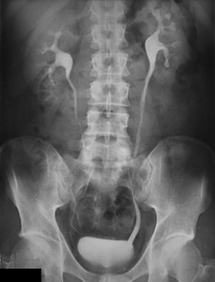
Requirements Removed 2022
HESI exam
Medical Law and Ethics
Microbiology

Slide 19
Mandatory Drug Screen & Criminal Background Check
Mandatory within 30 days of beginning the first semester of clinical experience.
While the College does not require drug screenings or criminal background checks of its School of Health Sciences students unless required by law to do so, the College cannot control or influence the requirements placed on the program by independent clinical sites.
The student’s successful completion of the Surgical Technology Program will be affected by the student’s ability to pass a drug screening test and/or a criminal background check.
The student will have to bear the cost of the testing.
Students are encouraged to discuss issues with the program chair prior to testing.

Slide 20

Mandatory Drug Screen
The drug testing will include testing for the following substances: amphetamines, barbiturates, benzodiazepines, cocaine, marijuana, methadone, methaqualone, opiates, PCP and Darvocet.
If urine is too dilute – test is repeated at student’s cost.

Slide 21
Criminal Background Check
The criminal background check will include:
  County Criminal Records (for the past 7 years, or since age 18 if less than 25 years old)
  Residency History & Social Security Number Verification
  Nationwide Sexual Offender Index
  Nationwide Healthcare Fraud and Abuse Scan (including Medicare & Medicaid Sanctioned Excluded Individuals, Office of Research Integrity (ORI)
  Office of Regulatory Affairs (ORA)
  FDA Debarment Check, Office of Inspector General (OIG)List of Excluded Individuals/Entities
  General Services Administration (GSA)-Excluded Parties List)
  the U.S. Patriot Act (including Terrorism Sanctioned Regulations, Office of Foreign Asset Control (OFAC)
  List of Specially Designated Nationals (SDN)
  U.S. Treasury, Department of State Trade Control (DTC) Debarred Parties

Slide 22

Vaccine requirements
CastleBranch will verify all vaccines
TB
MMR
Measles
Covid-19
Chicken pox
Dtap
Hep B
Flu
This Photo by Unknown Author is licensed under CC BY-NC-ND

Slide 23
Other Requirements for Clinical
CPR – by American Heart Association
Fit testing – N95
HIPAA training
Code of Conduct
Acknowledgement of Handbook

Slide 24
National Certification Exam
Taken at the end of the 2nd year in July
Cost of the exam is included in your tuition for summer
Ivy Tech does not guarantee passing the exam
Cost of retaking the National exam is up to the student ($250)
175 questions on exam – 106 correct to pass
Must be certified to work in Indiana

